Slide 1
Incident Life Cycle
Incident Management
- Ramana Nandam (27th Jan, 2015)

Slide 2
Agenda
Ticket Identification & Detection
Major Incident Management Process
Investigation & Resolution
Incident Downgrade/Upgrade
Triage Function
SLA Matrix
Escalation Matrix
Technical Communication Document

Slide 3
Ticket Identification & Detection
Ticket Initiator notifies Abbott GSD for ticket creation.
Abbott GSD determines the support group for the product.
Abbott GSD will assign the ticket to Cognizant(Service Provider) Support queue.
All Cognizant Support queues are monitored by Cognizant Monitoring Team 24*7*365 for response/resolution SLAs.
If the priority is Critical/High, Monitoring team will assign the ticket to the respective support person and will notify Incident Management and application support team via email.
If the priority is Medium or Low, ticket will be assigned to the respective application support person and an automated email notification will be sent to the assignee from ITSM.
Application Support team will check if the priority is correct based on Impact and Urgency.
If the Priority is not correct, Application team will contact Incident Manager with justification for upgrading/downgrading.
slide# 6 details about Incident Downgrade/Upgrade process.

Slide 4
Major Incident Management Process
Incident Manager will call the Application Support team to gather information on about business impact, issue description and current status of the issue.
An Initial Technical Communication will be sent within 30 minutes to the respective Domain Business Run Leads for All P1 and P2 (Extensive/Widespread) Incidents.
A war room call will be opened between all the resolver groups until resolution
Application Support team will investigate to fix the issue
Incident Manager will send Update Technical Communication for every one hour until resolution.(see Appendix)
Interim Update will be sent to the internal Cognizant Audience with current status of the issue.
Once issue resolved, Application Support Team will check with user for issue resolution confirmation.
Ticket will be kept in pending until user confirmation
IM to send Final technical communication to Abbott BSS Run leads and internal stakeholders.
Once issue resolved for P1 and P2(Extensive/Widespread) incidents, Application Support team/SMO Problem Management team will initiate a problem process and will complete the process.

Slide 5
Issue Investigation & Resolution
If the priority of the incident is P3 or P4, Application Support team will send the acknowledgement email to user and will update the work log.
Application Support team will analyze the issue and contact user for any clarifications.
A ticket will be kept in pending with client action required status until the information provided.
Application Support team will contact user for confirmation once the issue is resolved.
A ticket will be moved to resolved status after user confirmation.
Note :
If any support required from third parties, the ticket will be transferred to the respective resolver group for action.
If any action or support required from Vendor, the ticket will be kept in pending with Third party action required status

Slide 6
Incident Upgrade/Downgrade
For changing the priority of the ticket, Application Support team will contact Incident Manager with justification (see Appendix).
Incident Manager notify Abbott Business Run Leads to approve the downgrade/upgrade
Incident Manager will send Downgrade/Upgrade Communication to the respective Domain Run leads
The priority will be downgraded/upgraded by Application Support team after the approval.
Application Support team will proceed with further investigation and actions until resolution.

Slide 7
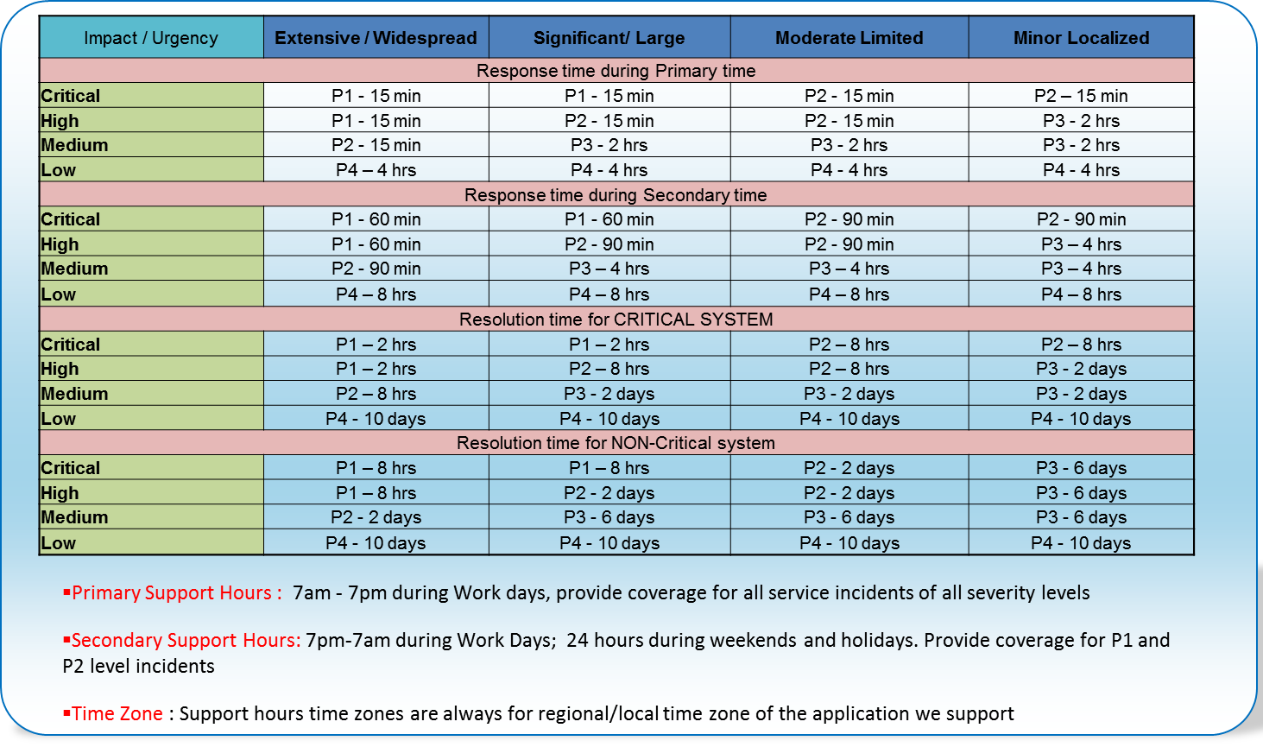
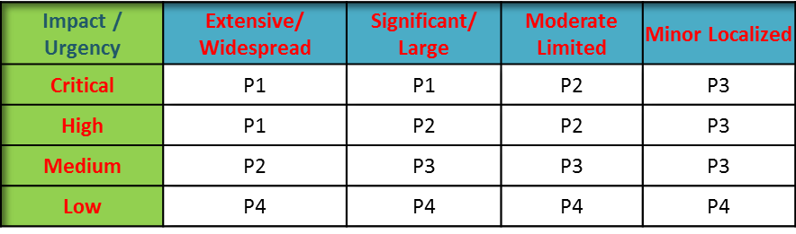
SLA Matrix

Slide 8
Escalation Matrix of Global Incident Management Team
Level 1 | Level 2 | Level 3 | Level 4
Incident Managers | SMO Global Service Lead | SMO Lead | Program Director
Anuja Savarivasan Email: Anuja.Savarivasan@cognizant.com Phone – 99423 34532 | Melwani, Kailash Email : Kailash.Melwani@cognizant.com Phone: 99520 23823 | KS, Balaji (Offshore), Email: Balaji.KS@cognizant.comPhone: +91-9790973765 | Venkat Hariharan (Offshore) Email: Venkat.Hariharan@cognizant.com Phone : +91-9003264207
M, Revathi Email: revathi.m@abbott.com Phone – 9840495377
Suresh , Email: suresh.p@abbott.com Phone - 99412 47274
 |  | Ramana Nandam Onsite (US), Email: Ramana.Nandam@ cognizant.com Phone: 001-847-767-7063 | Ram Athamanathan Onsite (US), Email: Ramkumar.Athmanathan@cognizant.com Phone: 001-317-370-6596
Aparna Email : aparna.r@abbott.com Phone - 96006 80414
Prakash J Email: Prakash.J@cognizant.com Phone – 87544 86336

Slide 9
Appendix

Slide 10

Abbott Proposed Process Work Flow

Slide 11
Major Incident (P1/P2) Management process Flow

Slide 12
Technical Communication Document

Slide 13
Thank you !

